Slide 1


Βάσεις Δεδομένων
Introduction to PL/pgSQL
InfoLab (infolab.cs.unipi.gr)
Τμήμα Πληροφορικής
Πανεπιστήμιο Πειραιώς
Βοηθοί Εργαστηρίου
Πέτρος Πέτρου
ppetrou@unipi.gr
Γιάννης Κοντούλης
ikontoulis@unipi.gr

Slide 2
Contents
InfoLab
Cursors
Βάσεις Δεδομένων

Slide 3
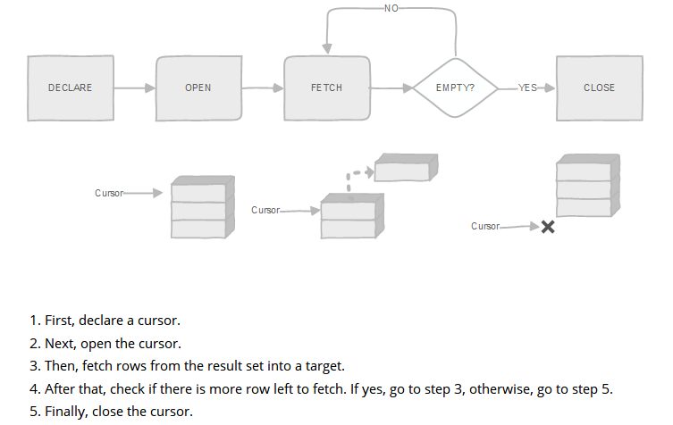
Cursor
InfoLab
Βάσεις Δεδομένων

Slide 4
Cursor Structure
InfoLab
Declare Cursors
cursor_name [ [NO] SCROLL ] CURSOR [( name datatype, name datatype, ...)] FOR query;
Example
DECLARE
cur_country CURSOR FOR SELECT * FROM country;
cur_country2 CURSOR (Country_Name TEXT) FOR SELECT * FROM country WHERE name=Country_Name;
Βάσεις Δεδομένων

Slide 5
Cursor Description
InfoLab
First, you specify a variable name for the cursor.
Next, you specify whether the cursor can be scrolled backward using the SCROLL. If you use NO SCROLL, the cursor cannot be scrolled backward.
Then, you put the CURSOR keyword followed by a list of comma-separated arguments (name datatype) that defines parameters for the query. These arguments will be substituted by values when the cursor is opened.
After that, you specify a query following the FOR keyword. You can use any valid SELECT statement here.
Βάσεις Δεδομένων

Slide 6
Opening Cursor (1/2)
InfoLab
Opening cursors
Cursors must be opened before they can be used to query rows. PostgreSQL provides syntax for opening an unbound and bound cursors.
Opening unbound cursors
We open an unbound cursor using the following syntax:
OPEN unbound_cursor_variable [ [ NO ] SCROLL ] FOR query;
Βάσεις Δεδομένων

Slide 7
Opening Cursor (2/2)
InfoLab
Because unbound cursor variable is not bounded to any query when we declared it, we have to specify the query when we open it. See the following example:
OPEN my_cursor FOR SELECT * FROM city WHERE population = pop;
PostgreSQL allows us to open a cursor and bound it to a dynamic query. Here is the syntax:
OPEN unbound_cursor_variable[ [ NO ] SCROLL ]
FOR EXECUTE query_string [USING expression [, ... ] ];
Βάσεις Δεδομένων

Slide 8
Using Cursor (1/4)
InfoLab
After opening a cursor, we can manipulate it using FETCH, MOVE, UPDATE, or DELETE statement.
Fetching the next row
FETCH [ direction { FROM | IN } ] cursor_variable INTO target_variable;
The FETCH statement gets the next row from the cursor and assign it a target_variable, which could be a record, a row variable, or a comma-separated list of variables. If no more row found, the target_variable is set to NULL(s).
Βάσεις Δεδομένων

Slide 9
Using Cursor (2/4)
InfoLab
By default, a cursor gets the next row if you don’t specify the direction explicitly. The following is the valid for the cursor:
NEXT
LAST
PRIOR
FIRST
ABSOLUTE count
RELATIVE count
FORWARD
BACKWARD
Βάσεις Δεδομένων

Slide 10
Using Cursor (3/4)
InfoLab
Note that FORWARD and BACKWARD directions are only for cursors declared with SCROLL option.
See the following examples of fetching cursors.
FETCH cur_country INTO rec_country;
FETCH LAST FROM rec_country INTO country, city;
Moving the cursor
MOVE [ direction { FROM | IN } ] cursor_variable;
Βάσεις Δεδομένων

Slide 11
Using Cursor (4/4)
InfoLab
If you want to move the cursor only without retrieving any row, you use the MOVE statement. The direction accepts the same value as the FETCH statement.
MOVE cur_country ;
MOVE LAST FROM cur_country;
MOVE RELATIVE -1 FROM cur_country;
MOVE FORWARD 3 FROM cur_country;
Βάσεις Δεδομένων

Slide 12
Cursor
InfoLab
cur_country CURSOR (dis TEXT) FOR
SELECT country.name as countryname, city.name as cityname
FROM country inner join city on (country.code=city.countrycode)
WHERE city.district=dis;
Βάσεις Δεδομένων

Slide 13
Cursor Running Example
InfoLab
CREATE OR REPLACE FUNCTION get_country_city (dis TEXT)
RETURNS TABLE (
country TEXT,
city TEXT
) AS $$
DECLARE
Βάσεις Δεδομένων

Slide 14
Cursor Running Example
InfoLab
rec_country RECORD;
cur_country CURSOR(dis TEXT) FOR
SELECT country.name as countryname, city.name as cityname
FROM country inner join city on (country.code=city.countrycode)
WHERE city.district=dis;
BEGIN
-- Open the cursor
OPEN cur_country(dis);
Βάσεις Δεδομένων

Slide 15
Cursor Running Example
InfoLab
LOOP
-- fetch row
FETCH cur_country INTO rec_country;
-- exit when no more row to fetch
EXIT WHEN NOT FOUND;
-- build the output
country := rec_country.countryname ;
Βάσεις Δεδομένων

Slide 16
Cursor Running Example
InfoLab
city := rec_country.cityname ;
RETURN NEXT;
END LOOP;
-- Close the cursor
CLOSE cur_country;
END; $$
LANGUAGE plpgsql;
SELECT * FROM get_country_city('Brest');
Βάσεις Δεδομένων

